Slide 1
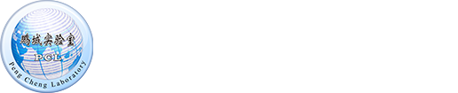


SketchINT: Empowering INT with TowerSketch for Per-flow Per-switch Measurement
Kaicheng Yang , Yuanpeng Li , Zirui Liu , Tong Yang,
Yu Zhou , Jintao He , Jing’an Xue , Tong Zhao ,
Zhengyi Jia , Yongqiang Yang
Notes:
Hello everyone, I’m Kaicheng Yang from Peking University. I’m going to introduce SketchINT: Empowering INT with TowerSketch for Per-flow Per-switch Measurement.

Slide 2

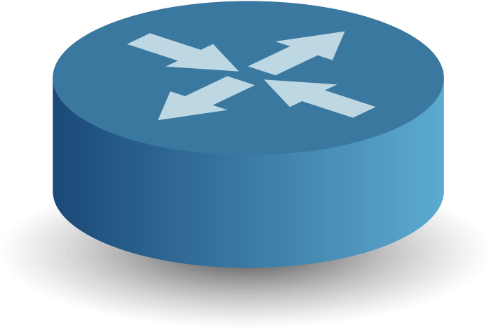
Background
Measurement is essential for successful network operations
Notes:
Network measurement is essential for successful network operations, especially when the network undergoes anomalies.

Slide 3

Background
High latency
What’s wrong
Notes:
For example, when the application detects significantly increased end-to-end latency, the operator may suspect that some switch may be congested. To pinpoint the culprit switch, an efficient measurement system that provides per-flow per-switch measurement is indispensable.

Slide 4
Background
Existing solutions
INT
sketching
others
suffer from high network overhead
cannot support per-flow per-switch measurement
cannot achieve both simplicity & accuracy
cannot support per-flow measurement
Notes:
At present, two most promising measurement solutions are in-band network telemetry solutions, short for INT, and sketching solutions.
按键
INT solutions obtain per-switch information by configuring the switches to insert INT information into each incoming packet
按键
. However, INT solutions suffer from high network overhead.
Sketching solutions use a kind of probabilistic data structures, namely sketches, to measure per-flow information with small memory usage and low bandwidth overhead.
按键
However, existing sketching solutions can hardly support per-switch measurement, and fail to achieve both simplicity and accuracy.
Specifically, simple sketches including the CM sketch and Count sketch, suffer from poor accuracy because they do not match the practical network traffic which is often highly skewed. Sophisticated sketches, including ElasticSketch and ASketch improve accuracy at the cost of complicated data structures and operations.
按键
Other solutions such as sampling and probing focus on link-level information, and cannot support even per-flow measurement.

Slide 5
Design Goal
Per-flow per-switch measurement
per-flow per-switch information for all flows (SketchINT)
Low network overhead
low bandwidth & packet number in collection compared to INT (SketchINT)
Simplicity & accuracy
ease of deployment and accuracy of measurement (TowerSketch)
Notes:
Our design goal is to overcome all the three shortcomings, while achieving per-flow per-switch measurement.
按键
Aiming at this goal, first, we propose SketchINT, a measurement system combing INT and sketches to support per-flow per-switch measurement
按键 with low network overhead.
按键
Second, we design TowerSketch, an ideal sketch for SketchINT to achieve both simplicity and accuracy.

Slide 6
SketchINT Overview
Switch: piggyback packet-level statistics using INT
End-host: encode INT information into TowerSketches
Analyzer: collect sketches and perform network-wide analysis
Notes:
Here is the workflow of SketchINT, which consists of three phases:
按键 piggybacking packet-level statistics using INT on switches,
按键 encoding INT information into TowerSketches on end-hosts,
按键 and collecting sketches and performing network-wide analysis on global analyzer.

Slide 7

SketchINT Overview
Piggyback packet-level statistics using INT
Analyzer
Switch
TCP
INThdr
INTinfo
INTinfo
Data
TCP
INThdr
INTinfo
Data
TCP
INThdr
INTinfo
INTinfo
INTinfo
Data
TCP
Host
Data
Notes:
按键
In the first phase, SketchINT leverages the INT capability of switches to acquire per-switch packet-level statistics. Like INT, for each packet, in each switch on its path, we insert the desired packet-level statistics as INT information into the packet.

Slide 8
SketchINT Overview
Encode INT information into TowerSketches on end-hosts
Analyzer
Switch
TCP
INThdr
INTinfo
INTinfo
INTinfo
Data
Host
+1
Notes:
In the second phase, rather than directly transmit INT information to the global analyzer as INT does.,
按键
SketchINT encodes INT information into sketches on end-hosts.
等动画结束，说话
Specifically, leveraging sketches, SketchINT first aggregates the per-packet INT information into a small amount of per-flow information, then further encodes the per-flow information into compact sketches. In this way, the bandwidth usage and the number of packets are significantly reduced.

Slide 9
SketchINT Overview
Collect sketches and perform network-wide analysis
Analyzer
Switch
Host
Window 0
Window 1
Notes:
In the third phase, SketchINT collects sketches and performs network-wide analysis. Each end-host maintains a group of active sketches and a group of idle sketches.
按键
The status of the two groups of sketches is periodically exchanged. At the same time, the end-host forwards the idle sketches to the global SketchINT analyzer.
动画结束说话
After collecting all local sketches, the global SketchINT analyzer will have a complete view of the whole network, and can then perform further analysis for each flow in each switch.

Slide 10
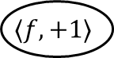
Classic CM Sketch
Using same-sized counters for each array
Selecting a counter in each array
+1
+1
$$⟨f,+1⟩$$
+1
A 3-array CM sketch
Notes:
Next, I will introduce the design of the well-known classic sketch, CM sketch.
按键
The CM sketch consists of several same-sized counter arrays. Each array uses a hash function to randomly and uniformly hash a flow into a counter in it.
按键
When flow f arrives, CM calculates hash functions to find a counter in each array and increments it by one.

Slide 11
Classic CM Sketch
Highly skewed network traffic pattern
Many bits wasted
Notes:
按键
However, the CM sketch suffers from poor accuracy because it treats each flow equally. The practical network traffic pattern is highly skewed: most flows are small and a small number of large flows contribute to most traffic. As shown in the figure demonstrating the probability density function of counters, we find that most counters record small numbers,
按键
and thus a large number of bits are wasted in the CM sketch.

Slide 12
Simple & Accurate TowerSketch
Using different-sized counters for different arrays
8-bit
4-bit
2-bit
A 3-array TowerSketch
Notes:
Based on this insight, we propose TowerSketch.
按键
TowerSketch is an ideal sketch that achieves both simplicity and accuracy for SketchINT. Based on the CM sketch, TowerSketch makes a small but non-trivial improvement. As shown in the example, TowerSketch uses different-sized counters for different arrays. In this way, TowerSketch wastes much less bits than the CM sketch, approaching a state that every bit is counting.

Slide 13
Simple & Accurate TowerSketch
Insertion
5
6
8-bit
12
13
4-bit
$$⟨f,+1⟩$$
3
2-bit
Overflowed！
A 3-array TowerSketch
Notes:
To insert flow f, similar to the CM sketch, for each array, TowerSketch selects one hashed counter to increment.
按键等结束
Some small-sized counters will inevitably reach their upper bounds, and TowerSketch regards their upper bounds as overflowed. TowerSketch regards overflowed counter as positive infinity, and never increment them.
按键等结束
As shown in the example, the 2-bit counter records three, and is not incremented.

Slide 14
Simple & Accurate TowerSketch
Conservative update
5
6
8-bit
12
12
$$⟨f,+1⟩$$
12>5！
4-bit
3
2-bit
Overflowed！
A 3-array TowerSketch
Notes:
TowerSketch can also support conservative update. Similar to the CU sketch, TowerSketch just increments the smallest counter(s) that are not overflowed.
按键等结束

Slide 15

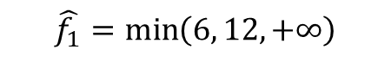



Simple & Accurate TowerSketch
Query
6
8-bit
12
$$\hat{f_{1}}=\min\left(6, ?, ?\right)$$
$$\hat{f_{1}}=\min\left(?, ?, ?\right)$$
$$\hat{f_{1}}=6$$
$$\hat{f_{1}}=\min\left(6, 12, ?\right)$$
$$⟨f,+1⟩$$
4-bit
$$\hat{f_{1}}=\min\left(6, 12, +∞\right)$$
3
Overflowed！
2-bit
A 3-array TowerSketch
Notes:
To query the flow size of flow f, TowerSketch returns the minimum value of the all hashed counters.
按键等结束
Recall that we treat the value of an overflowed counter as +∞.
按键等结束
As shown in the example, the 2-bit counter records three, and is regard as positive inifinity.
按键等结束
In this example the estimated flow size of flow f is six

Slide 16
6 Local Measurement Tasks
Flow size estimation
Heavy hitter detection
Heavy change detection
Flow size distribution estimation
Entropy estimation
Cardinality estimation
Notes:
With TowerSketch, SketchINT can support 6 local measurement tasks with high accuracy, including
flow size estimation,
heavy hitter detection,
heavy change detection,
flow size distribution estimation,
entropy estimation,
and cardinality estimation.

Slide 17
4 Global Measurement Tasks
Per-flow per-switch latency estimation
Per-flow per-switch inflated latency detection
Per-switch heavy hitter detection
Per-switch heavy change detection
Notes:
SketchINT can also support 4 global measurement tasks, including
per-flow per-switch latency estimation,
per-flow per-switch inflated latency detection,
per-switch heavy hitter detection,
and per-switch heavy change detection.

Slide 18
Flexible working modes
TowerSketch can be implemented upon a diversity of platforms
Operators enjoy great simplicity of SketchINT deployment!!
P4-capable Edge Switch
FPGA-based SmartNIC
End-host
Notes:
With the great simplicity, TowerSketch can be implemented upon a diversity of platforms, giving operators great flexibility of SketchINT deployment. We have completed three types of TowerSketch implementations in CPU, P4, and FPGA platforms.
按键
Operators can not only build TowerSketches in end-hosts,
按键
but also other hardware platforms such as P4-capable switches
按键 and FPGA-based smartNIC to save precious CPU resources.
按键
切页面

Slide 19
Limitation in P4 platform
Tofino switches only support 8-bit,16-bit and 32-bit counters
Support 2-bit, 4-bit counters at the cost of extra memory (overflow bits)and complicated operations (mirror, recirculate).
Notes:
A small regret in P4 platform is that existing Tofino switches only naturally support 8-bit,16-bit and 32-bit counters.
To support 2-bit and 4-bit counters, we need extra memory as flag bits, and complicated operations such as mirror and recirculate.

Slide 20
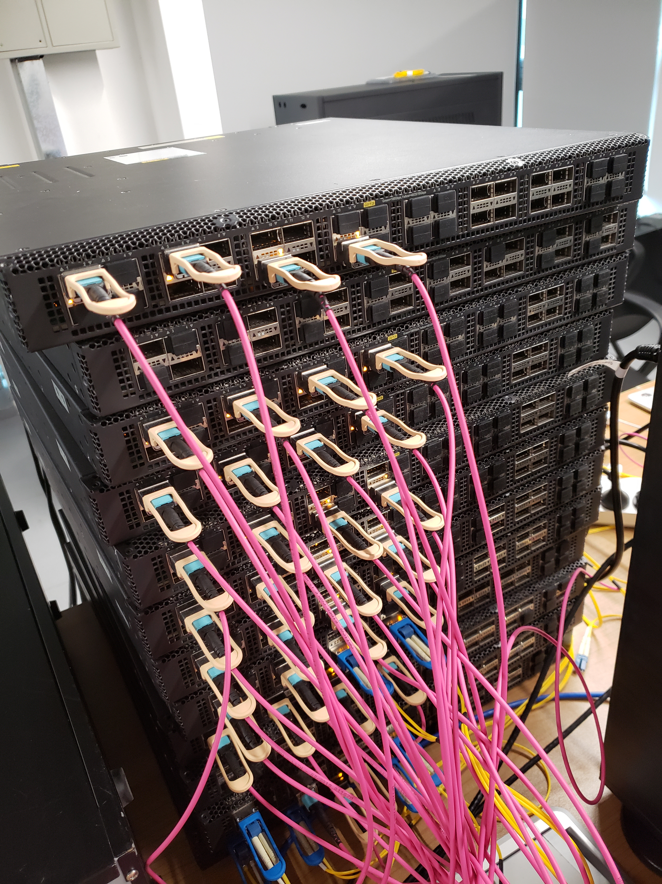
Experimental Results
Testbed
Toﬁno-40GbE
Notes:
Finally, let’s take a look at our experimental results. We have fully implemented our SketchINT prototype on a testbed with 10 Tofino switches and 8 servers. We collect traces from end-hosts to evaluate the accuracy of our solutions.

Slide 21
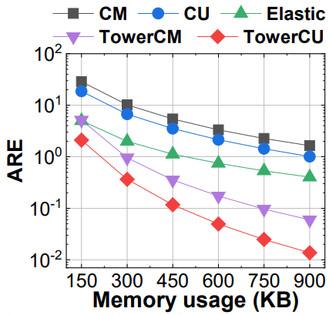
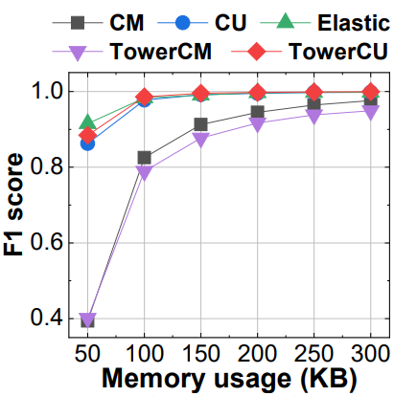
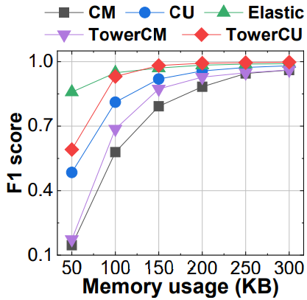
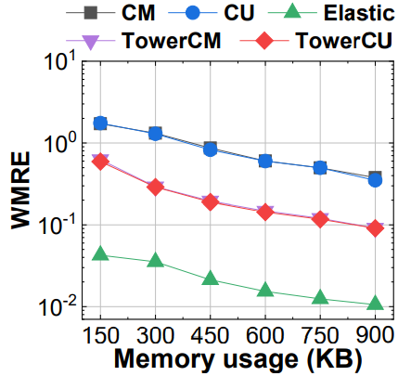
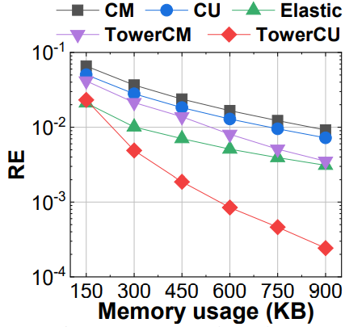
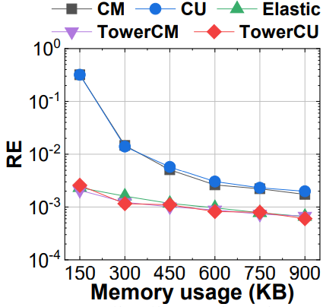
Experimental Results
How accurate can TowerSketch perform the 6 local measurement tasks
Flow size estimation
Heavy hitter detection
Heavy change detection
Flow size distribution estimation
Entropy estimation
Cardinality estimation
Notes:
Our experiments focus on the following three issues.
按键
The first issue is how accurate can TowerSketch perform the 6 local measurement tasks.
按键6次
Our experimental results show that the accuracy of Towersketch is much higher than CM and CU sketch.
In most tasks, the performance of Towersketch is better than ElasticSketch, which is the state-of-the-art sketch in flow size estimation.

Slide 22
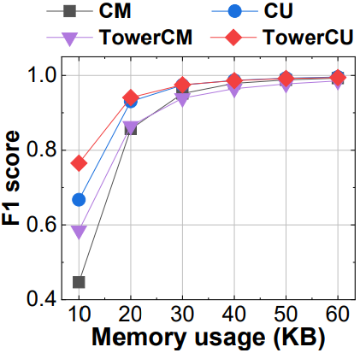
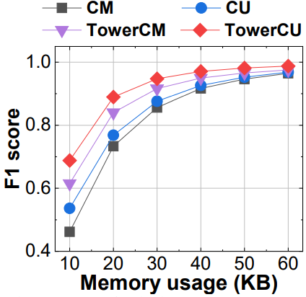
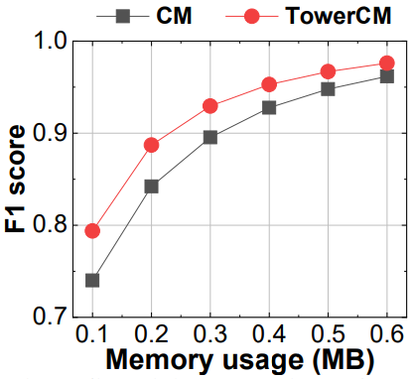
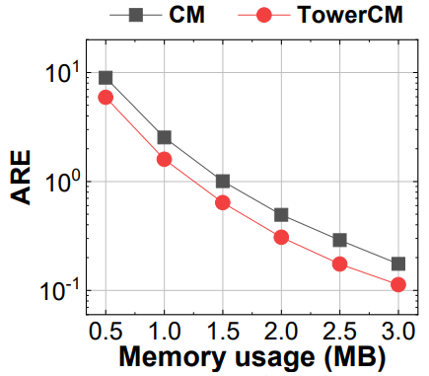
Experimental Results
How accurate can TowerSketch perform the 4 global measurement tasks
Per-flow per-switch latency estimation
Per-flow per-switch inflated latency detection
Per-switch heavy hitter detection
Per-switch heavy change detection
Notes:
The second issue is how accurate can TowerSketch perform the 4 global measurement tasks.
按键4次
Our experimental results show that the accuracy of Towersketch is much higher than CM and CU sketch.
Note that we don’t compare ElasticSketch as it cannot naturally support these global tasks.

Slide 23
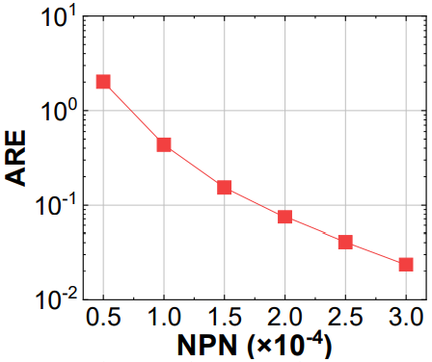
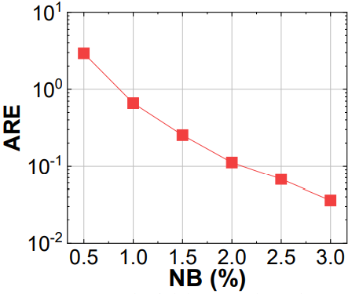
Experimental Results
How much network overhead can SketchINT reduce in collection?
Packet number comparison
Bandwidth overhead comparison
Notes:
The third issue is how much network overhead can SketchINT reduce in collection. We compare SketchINT with INT-passport mode, which mirrors all INT information to the global analyzer in the sink node.
按键两次
The results show that only three percent Normalized Bandwidth and three ten-thousandth Normalized Packet Number can achieve ARE less than five percent in per-flow per-switch latency estimation task.

Slide 24
SketchINT
Per-flow per-switch measurement
combine INT and sketches
Low network overhead
compress INT information at the edge of network
Simplicity & accuracy
design a novel TowerSketch
Notes:
In summary, we propose SketchINT, a measurement system provides per-flow per-switch measurement with low network overhead while achieving simplicity and accuracy.
SketchINT achieves per-flow per-switch measurement by combing INT and sketches.
SketchINT achieves low network overhead by compressing INT information at the edge of network.
SketchINT achieves simplicity and accuracy by designing a novel TowerSketch.

Slide 25
SketchINT
Thank you!
Notes:
That’s all. Thank you for your listening.

